Slide 1
UBER ANALYSIS
Name: Vijayalakshmi R Department:MCA (BCU) Semester:Third
USN: P18BR23S126026

Slide 2
Outline
Title Name
Outline
Abstract
Problem Statement
Proposed Solution
Short Video
Implementation
Output Screenshots
References

Slide 3
Abstract:
This project focuses on analyzing Uber trip data to uncover patterns, trends, and insights that can improve operational efficiency and enhance user experience.
we examine key aspects such as ride demand patterns, peak usage times, geographical trip distributions, and fare structures.
Steps include datapreprocessing,model training,and evaluation,followed by actionable insights for business decision-making.

Slide 4
Problem Statement
The increasing demand for ride-hailing services like Uber presents challenges in optimizing operational efficiency, meeting customer expectations, and ensuring equitable driver distribution.
Identifying peak demand periods and high-demand locations.
Reducing customer wait times and improving driver allocation.

Slide 5

Proposed Solution
Loading the Dataset:Import andexplore thecustomer churn dataset.
Data Pre-processing:
Handle missing values. Encoded categorical variables. Address any class imbalance.
Feature Splitting:Divide thedatainto trainingandtestingsubsets.
ModelTraining:Use logisticregression to trainthemodel.
Evaluation:Assess model performance using:
Accuracy
Classification Report
Confusion Matrix

Slide 6
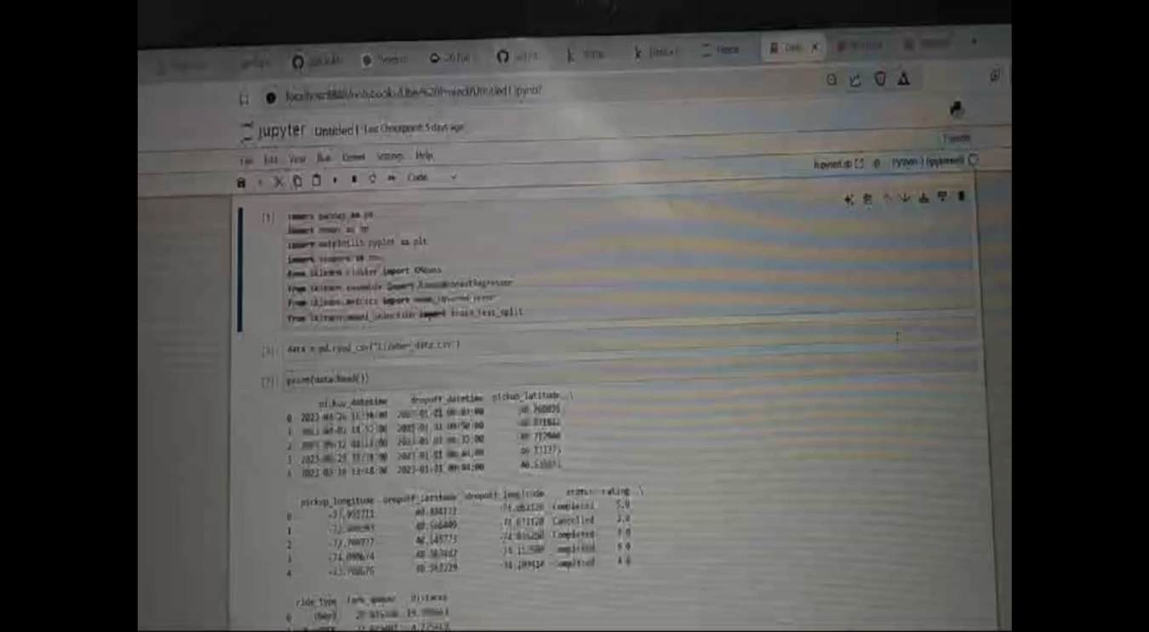
Short Video

Slide 7
Implementation
https://github.com/Vijeelakshmir

Slide 8
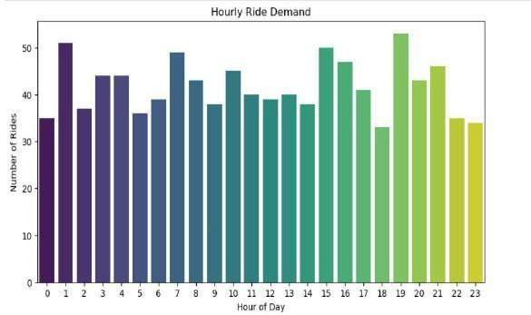
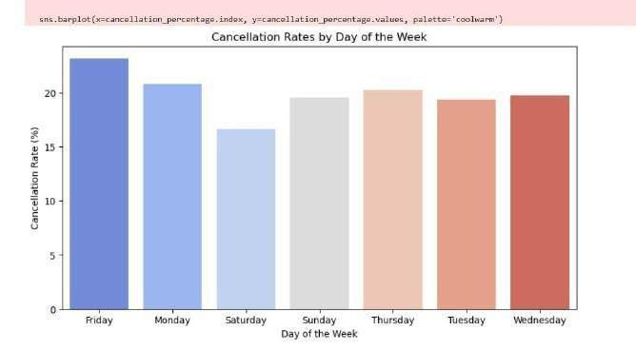
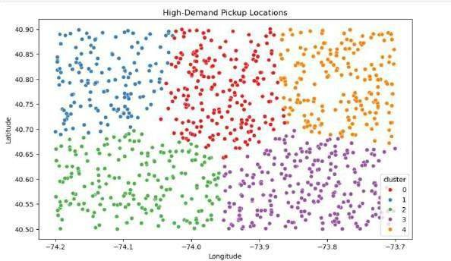
Output

